Slide 1
Parallel and Distributed Computing Overview (CS 3006)
Dr. Shujaat Hussain
National University of Computer & Emerging Sciences, Islamabad Campus

Slide 2
Parallel and Distributed Computing?
What is Parallel and Distributed Computing?
Use of multiple processors or machines working together on a common task
Each processor/machine works on its section of the problem
Processors may exchange information

Slide 3
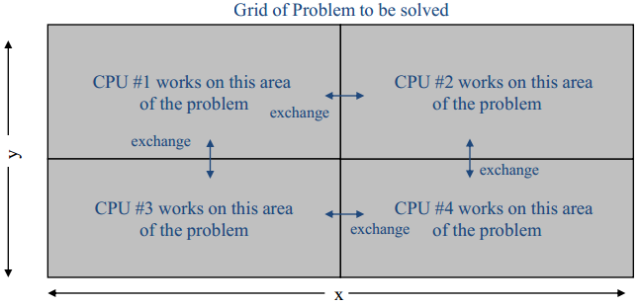
Parallel and Distributed Computing?

Slide 4
Why Parallel and Distributed Computing?
Goal: solve large problems more quickly
Parallelism provides:
Solving large problems in same time (or even less)
Solve fixed size problems faster
Grain of parallelism: How big are the units?
Bits, Instructions, Blocks, Loop iterations, Procedures, …
Notes:
Bit-level parallelism is a form of parallel computing based on increasing processor word size. Increasing the word size reduces the number of instructions the processor must execute in order to perform an operation on variables whose sizes are greater than the length of the word.
Instruction-level parallelism means the simultaneous execution of multiple instructions from a program. While pipelining is a form of ILP, we must exploit it to achieve parallel execution of the instructions in the instruction stream.

Slide 5
Example Parallel Machines
Examples of parallel machines/hardware:
A Chip Multi-Processor (CMP) contains multiple cores on a single chip
A shared memory multi-processor by connecting multiple processors to a single memory system
A distributed computer contains multiple machines combined together with a network such as Cluster, Grid, Cloud, etc.

Slide 6
Why do parallel computing?
Two main aspects:
Technology Push
Applications Pull
Acknowledgements: Department of Computer Science Rice University

Slide 7
Why do parallel computing?
Technology Push

Slide 8
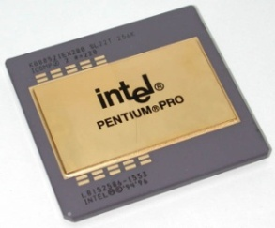


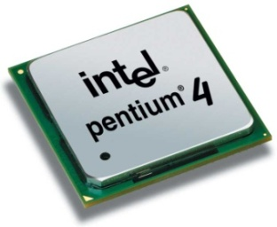
Single Processor Systems
From mid-1980s until 2004 computers got faster:
More number of transistors were packed every year.
Size of transistors continued to get smaller
Resulted in faster processors (frequency scaling method → more GHzs means more performance) - as observed in Moore’s law
Notes:
Moore's law is the observation that the number of transistors in a dense integrated circuit doubles about every two years. Moore's law is an observation and projection of a historical trend

Slide 9
Moore’s Law
An observation by Gordon Moore (co-founder of Intel)
Projection based on historical trend (processor design) in 1970s
Number of transistors in a processor doubles every year
The real-data shows the correlation:
Number of transistors doubled every 18 months

Slide 10
ACK: shigeru23 CC BY-SA 3.0, via Wikimedia Commons

Slide 11
Moore’s Law
More transistors → more parallelism opportunities
Implicit Parallelism (hidden from programmer):
Execution pipelines, multiple-functional units, etc
Explicit Parallelism:
VLIW, More execution Units
Higher packing density means shorter electrical paths, giving higher performance
Notes:
Very long instruction word (VLIW) refers to instruction set architectures designed to exploit instruction level parallelism (ILP). Whereas conventional central processing units (CPU, processor) mostly allow programs to specify instructions to execute in sequence only, a VLIW processor allows programs to explicitly specify instructions to execute in parallel. This design is intended to allow higher performance without the complexity inherent in some other designs.

Slide 12
Problems with single “Faster” CPU
Power Consumption:
With growing clock-frequencies, power consumption increases exponentially
Not possible forever: a higher frequency processor could have require a whole nuclear reactor to fulfill the energy needs

Slide 13

Problems with single “Faster” CPU
Heat Dissipation:
With growing clock frequency, more power is consumed → More heat is dissipated..
Keeping processors cool become a problem (with increasing clock frequencies)

Slide 14
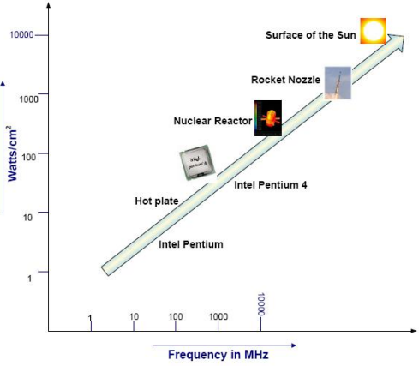
Problems with single “Faster” CPU

Slide 15
Other Issues…
Smaller size of transistors:
Fabrication of processors become more difficult.
Limited memory size:
A single processor has limited internal memory i.e., cache memory L1, L2, registers, etc.
A single processor based system has limited overall system memory or main memory.

Slide 16
https://www.nytimes.com/2004/05/17/business/technology-intel-s-big-shift-after-hitting-technical-wall.html
Acknowledgements: Department of Computer Science Rice University

Slide 17
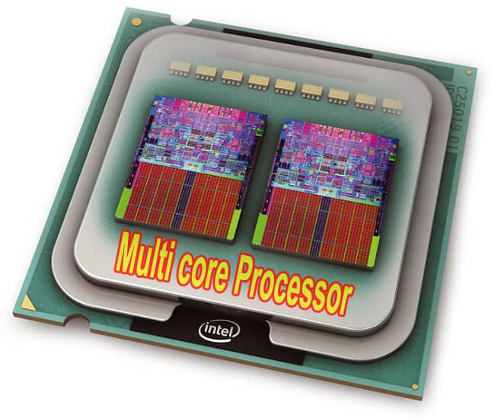
Multi-core Era
[Picture credit: https://i.ibb.co/4ftNR3z/mlcore-copy.jpg

Slide 18
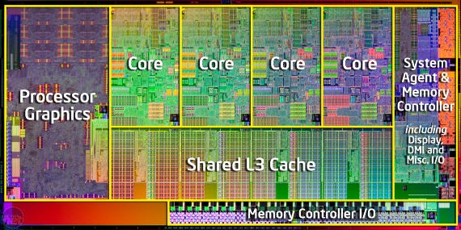
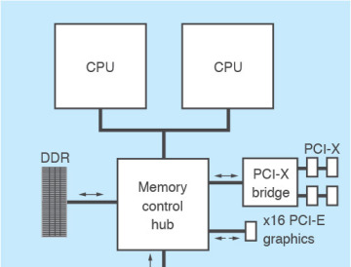
Multi-core Processors
Single-core processors reached their physical limits:
Overheating issues
Huge power consumption requirements
Difficult to design
[Picture credits: Intel Corporation, ]

Slide 19
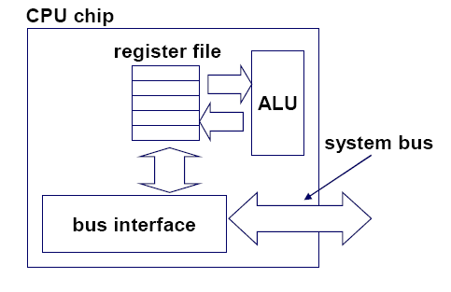
Typical Single-core Processor
Single Execution Unit
Notes:
Register file: Area of processor registers

Slide 20
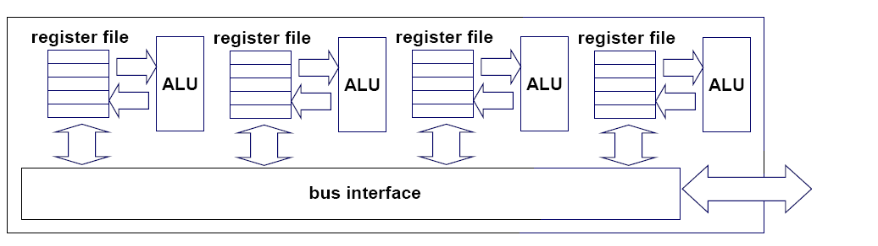
Multi-core architectures
Replicated multiple processor on a single die/chip
Core 1
Core 2
Core 3
Core 4
Multi-core CPU chip

Slide 21
Serial Performance Scaling is Over
Cannot continue to scale processor frequencies
no 20 GHz chips
Cannot continue to increase power consumption
can’t melt chip
Can continue to increase transistor density
as per Moore’s Law
Notes:
The upshot of the power trend is that the epoch of serial performance scaling is over.
A glance across the CPU landscape reveals that single cores aren’t getting any faster: no architect has found a way to design 10 GHz chips.
We have to design underthe annoying constraint that the processor cannot melt once you flip the power switch.
So what can we do: transistors can continue to shrink, so we can increase transistor density. That is, we can fit more and more transistors onto a single chip.

Slide 22
The “New” Moore’s Law
Computers no longer get faster, just wider
You must re-think your algorithms to be parallel !
Data-parallel computing is most scalable solution:
2 cores
4 cores
8 cores
16 cores…
Notes:
The tide of commodity technology is rising in a different direction.
To first order, computers have stopped getting faster (higher clock speeds), they just get wider (more parallel)
If you work on an interesting problem, you *must* re-think your algorithms to be parallel
* Otherwise, if your serial algorithm isn't fast enough today it never will be fast enough
Data-parallel computing is the most scalable solution
* Another option is to tease your code apart, move this task (say I/O) to one core and that task (compute) to another core, oh wait now there's 4 cores, um, let's put mouse and keyboard handing on one core and split compute into database access and the linear algebraic solver, oops now there's 8 cores lets split up the solver into LU decomposition and .... you get the idea
* if your problem is of interesting size the data will always outnumber the cores, so organize the computation around the data

Slide 23
Generic Multicore Chip
Processor
Local Memory
Processor
Local Memory
Global Memory
Handful of processors each supporting ~1 hardware threads
On-chip memory near processors (cache, RAM, or both)
Shared global memory space (external DRAM)
Notes:
One instance of this idea is the current wave of multicore CPUs.
In this generic design, you’ve got a few processors which each support around one thread in hardware. Paired with each hardware thread, you’ve also got relatively lots of on-chip memory near the processors for local computation. Farther out, you’ve got a shared global memory space which the processors can communicate through to enable cooperation on

Slide 24
Generic Many-core Chip
Processor
Memory
Processor
Memory
• • •
Global Memory
Many processors each supporting many hardware threads
On-chip memory near processors (cache, RAM, or both)
Shared global memory space (external DRAM)
Notes:
Alternatively, a manycore parallel architecture replicates many processor cores, each hosting several lightweight hardware threads. Like a multicore architecture, each processor is paired with a dedicated on-chip memory, but per-thread memory resources are relatively smaller.
Because the on-chip memory is shared among a processor’s threads, it serves as a convenient venue for thread communication/cooperation
Again, the shared global memory space serves as a forum for inter-core communication/cooperation (threads in differing processors may communicate here)

Slide 25
Technology Trends and Multicores

Slide 26
Multi-core CPU chip
The cores fit on a single processor socket
Also called Chip Multi-Processor (CMP)
core
1
core
2
core
3
core
4

Slide 27
Multi-core CPU chip
thread 1
thread 2
thread 3
thread 4
core
1
core
2
core
3
core
4

Slide 28
Threads may be time-sliced (like a uniprocessor)
several threads
several threads
several threads
several threads
core
1
core
2
core
3
core
4

Slide 29
Other Option: Simultaneous Multithreading
several threads
several threads
several threads
several threads
core
1
core
2
core
3
core
4

Slide 30
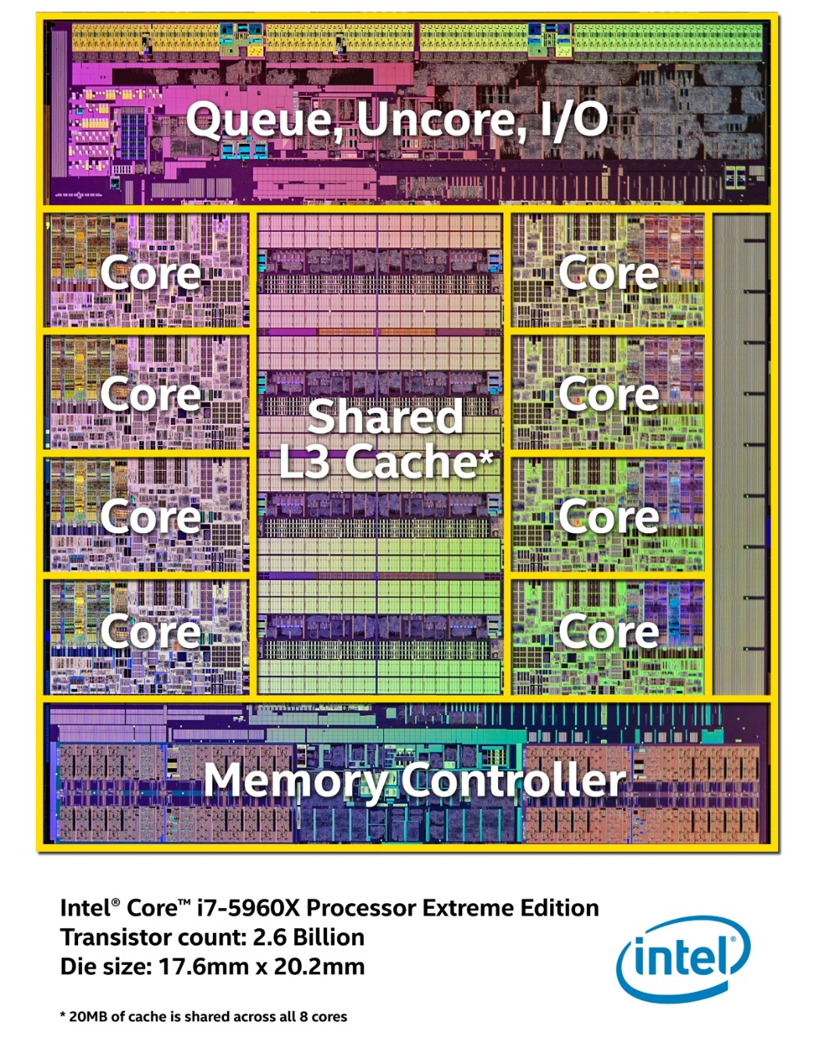
8-Core Core-i7 Processor (Extreme Edition)
http://simplecore.intel.com/newsroom/wp-content/uploads/sites/11/HSW-E-Die-Mapping-Hi-Res.jpg

Slide 32
Mobile Parallel Processing

Slide 33
Mobile Parallel Processing

Slide 34
Why do parallel computing?
Application Pull

Slide 35
Why do parallel computing?
Plamen Krastev@San Diego State University

Slide 36
Why do parallel computing?
Plamen Krastev@San Diego State University

Slide 37
Parallelizing Applications

Slide 38

Traditional vs. Parallel Applications
Traditionally, software has been written for serial computation:
To be run on a single computer having a single Central Processing Unit (CPU);
A problem is broken into a discrete series of instructions.
Instructions are executed one after another.

Slide 39

Traditional vs. Parallel Applications
In the simplest sense, parallel execution is the simultaneous use of multiple compute resources to solve a computational problem
To be run using multiple CPUs (on same or different machines)
A problem is broken into discrete parts that can be solved concurrently
Each part is further broken down to a series of instructions

Slide 40
Some Terminologies
Task
A logically discrete section of computational work.
A task is typically a program or program-like set of instructions that is executed by a processor.
Parallel Task
A task that can be executed by multiple processors safely (producing correct results)
Serial Execution
Execution of a program sequentially, one statement at a time using one processor.

Slide 41
Parallelization Strategy
Problem Understanding
Partitioning/Decomposition
Assignment
Orchestration
Mapping

Slide 42
Parallelization Strategy - Overview

Slide 43
Parallelization Strategy
Problem Understanding
Partitioning/Decomposition
Assignment
Orchestration
Mapping

Slide 44
1. Problem Understanding
The first step in developing parallel application is to Understand the Problem (that you wish to solve)
Starting with a serial program → Understanding the existing code
The first decision → Whether or not the problem is suitable for parallelization?
Code Dependencies
Communication
Synchronization
Notes:
A code with high Dependency in code, Communication, and Synchronization decreases its suitability to parallelize it.

Slide 45
1. (a) Identify the Programs hot-spots
Know where most of the real work is being done. (The majority of scientific and technical programs usually accomplish most of their work in a few places.)
Profilers and performance analysis tools can help here
Focus on parallelizing the hotspots and ignore those sections of the program that account for little CPU usage.

Slide 46
1. (a) Identify the Programs hot-spots
Identify areas that are unjustly slow?
Example: I/O is usually something that slows a program
Potential Solutions:
Restructure the program
Use a different algorithm
Overlap the communication with computation

Slide 47
Parallelization Strategy
Problem Understanding
Partitioning/Decomposition
Assignment
Orchestration
Mapping

Slide 48
2. Partitioning/Decomposition
Divide work into discrete "chunks"
Broken chunks can be assigned to specific tasks
Tasks could be executed concurrently
Decomposition: (1) Domain decomposition (2) Functional decomposition
Decomposition Granularity:
Fine-grain: large number of small tasks
Coarse-grain: small number of large tasks
Fine-grained tasks
Coarse-grained tasks

Slide 49
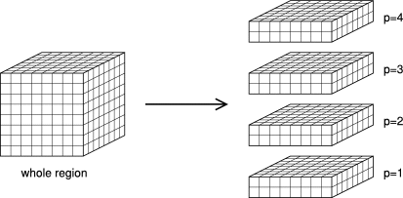
2. (a) Domain Decomposition
The data associated with a problem is decomposed
Each parallel task then works on a portion of the data

Slide 50
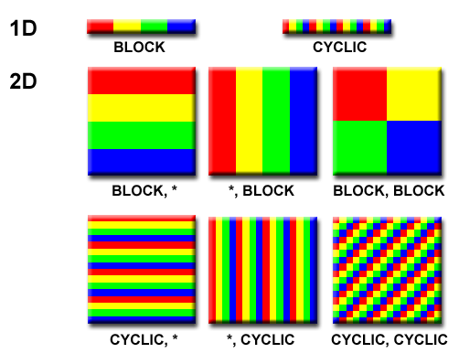
2. (a) Domain Decomposition
1D Data Decomposition:
Block: same sized large blocks (typically == number of parallel tasks) - Pros & Cons?
Cyclic: small-sized many blocks (typically >> number of parallel tasks) - Pros & Cons?

Slide 51
2. (a) Domain Decomposition
2D Data Decomposition:
Block (row*,column*): same sized large blocks (row or column) (typically == number of parallel tasks) - Pros & Cons?
Block (row,column): small sized sub-blocks (typically == number of parallel tasks) - Pros & Cons?

Slide 52
2. (a) Domain Decomposition
2D Data Decomposition:
Cyclic (row*,column*): small-sized many blocks (row or column) (typically >> number of parallel tasks) - Pros & Cons?
Cyclic (row,coulmn): small-sized many sub-blocks (typically >> number of parallel tasks) –
Pros & Cons?

Slide 53
2. (b) Functional Decomposition
Focus is on the computation that is to be performed
The problem is decomposed according to the work (instructions) that must be done
Each sub-task performs a portion of the overall work

Slide 54
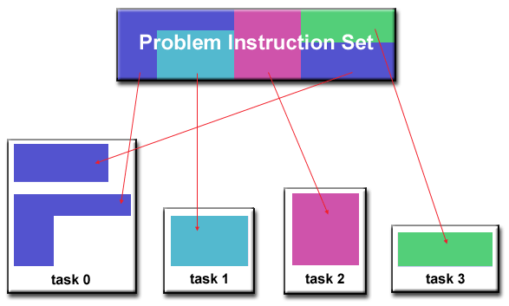
2. (b) Functional Decomposition
Functional decomposition useful to the problems that can be split into different tasks
Examples:
Ecosystem Modeling
Signal Processing
Climate Modeling

Slide 55
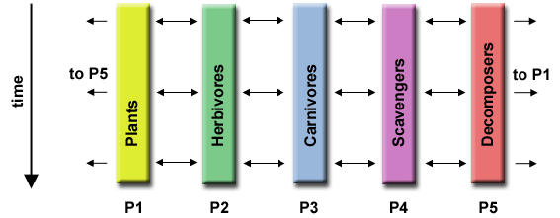
Ecosystem Modeling
Each program calculates the population of a given group, where each group's growth depends on that of its neighbours.
As time progresses, each process calculates its current state, then exchanges information with the neighbour populations.
All tasks then progress to calculate the state at the next time step.

Slide 56
Parallelization Strategy
Problem Understanding
Partitioning/Decomposition
Assignment
Orchestration
Mapping

Slide 57
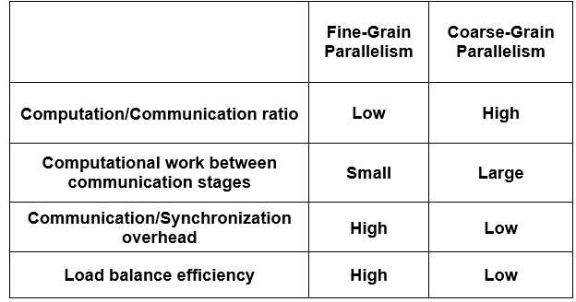
3. Assignment
Composing “Fine-grained” parallel computations into processes or coarse-grained tasks
Considerations while composing tasks: Load-balance, Uniform communication, ease of Synchronization
Notes:
In general, when synchronization is expensive, coarse granularity is preferred whereas if there are few units of execution and time disparity, fine granularity is desired.

Slide 58
Parallelization Strategy
Problem Understanding
Partitioning/Decomposition
Assignment
Orchestration
Mapping

Slide 59
4-5. Orchestration & Mapping
Following aspects should be considered before actual mapping (Scheduling):
Inter-task communication
Synchronization among tasks
Data locality aspect
Other system related considerations (NUMA, etc.).

Slide 60
Communication

Slide 61
Who Needs Communications?
No Communication Required:
Some problems can be decomposed and executed in parallel with virtually no need for tasks to share data:
Imagine an image processing operation where every pixel in a black and white image needs to have its color reversed
These types of problems are often called Embarrassingly Parallel because they are so straight-forward.
Very little or No inter-task communication is required

Slide 62
Who Needs Communications?
Communications Required
Most parallel applications are not quite so simple,
They do require tasks to share data with each other
For example: a 3-D heat diffusion problem requires a task to know the temperatures calculated by the tasks that have neighbouring data
Changes to neighbouring data has a direct effect on that task's data

Slide 63
Communication Cost
Inter-task communication virtually always implies overhead
CPU time and resources are used to package and transmit data
Communications mostly require some synchronization between tasks → Results in waiting time
Communication can saturate the available network bandwidth, further reducing performance

Slide 64
Latency & Bandwidth
Latency is the time it takes to send a message from point A to point B
Bandwidth is the amount of data that can be communicated per unit of time
Sending many small messages can cause a higher overall latency
Efficient approach is to package small messages into a larger message
To maximize bandwidth usage & Reduce Overhead

Slide 65
Visibility of communications
In Distributed memory model, communications are explicit and under the control of a programmer
In Shared memory mode communications are implicit (transparently to the programmer)

Slide 66
Communication Patterns
Synchronous communication: require some type of "handshaking" between tasks
Blocking communications (since other task must wait until the communications have completed)
Asynchronous communications: allow tasks to transfer data independently from one another
non-blocking communications
Interleaving computation with communication is the single greatest benefit

Slide 67
Scope of Communication
Knowing which tasks must communicate with each other is critical during the design stage of a parallel code
Point-to-point - involves two tasks with one task acting as the sender/producer of data, and the other acting as the receiver/consumer.
Collective - involves data sharing between more than two tasks, which are often specified as being members in a common group, or collective.

Slide 68
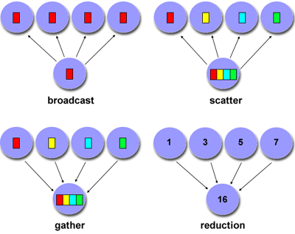
Collective Communications

Slide 69
Synchronization

Slide 70
Synchronization
Synchronization: mechanism for coordination and sequencing of parallel tasks
Significant factor in program’s performance
Often requires "serialization" of program segments

Slide 71
Synchronization Types
Barrier
Usually all tasks are involved
Each task performs its work until it reaches the barrier. It then stops, or "blocks”
When the last task reaches the barrier, all tasks resume

Slide 72
Synchronization Types
Lock / semaphore
Can involve any number of tasks
Typically used to serialize (protect) access to global data/code. Only one task at a time may use (own) the lock / semaphore / flag.
The first task to acquire the lock "sets" it
Other tasks can attempt to acquire the lock but must wait until the task that owns the lock releases it
Can be blocking or non-blocking

Slide 73
Synchronization Types
Synchronous communication Operations
Involves only those tasks executing a communication operation
Before initiating the communication, acknowledgement must be received (OK to send)

Slide 74
Any Questions?

